Slide 1
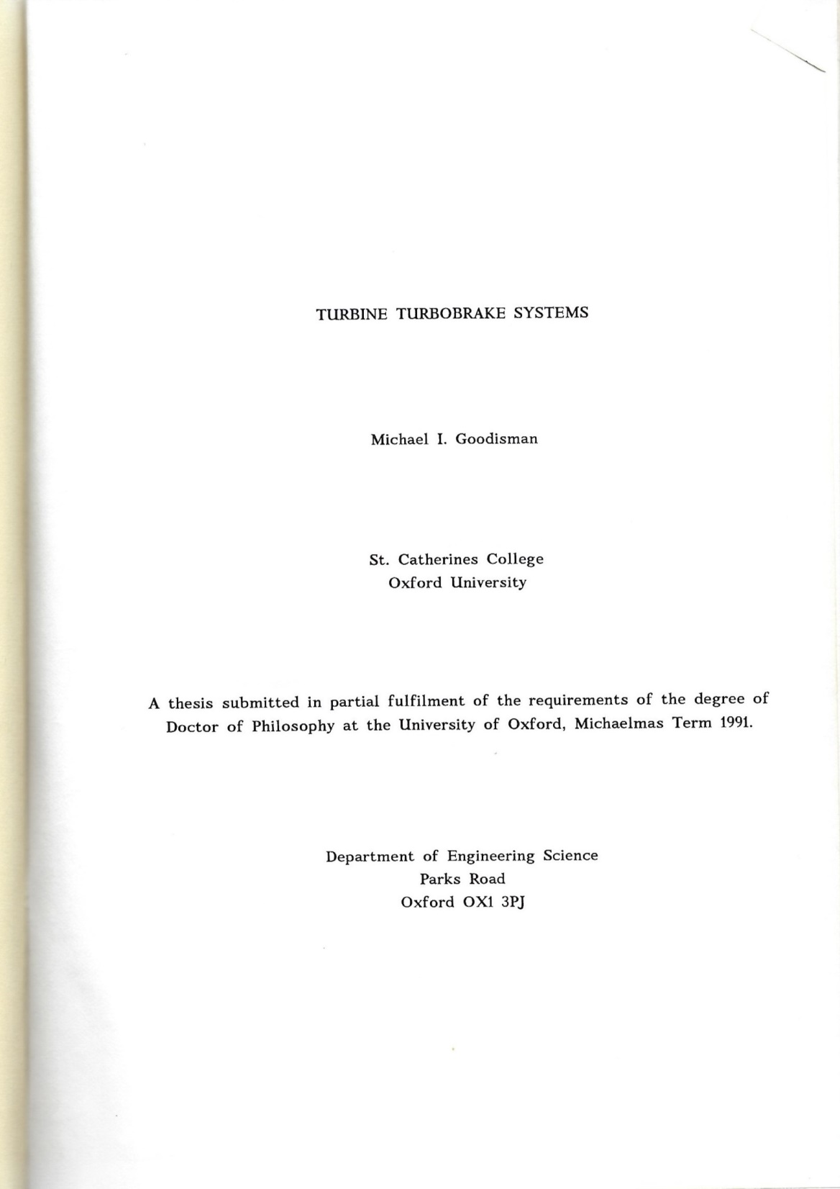
A snapshot of my thesis of 1991 is shown on these pages. Requests for further content from the thesis should be made directly to the Oxford Thermofluids Institute

Slide 2
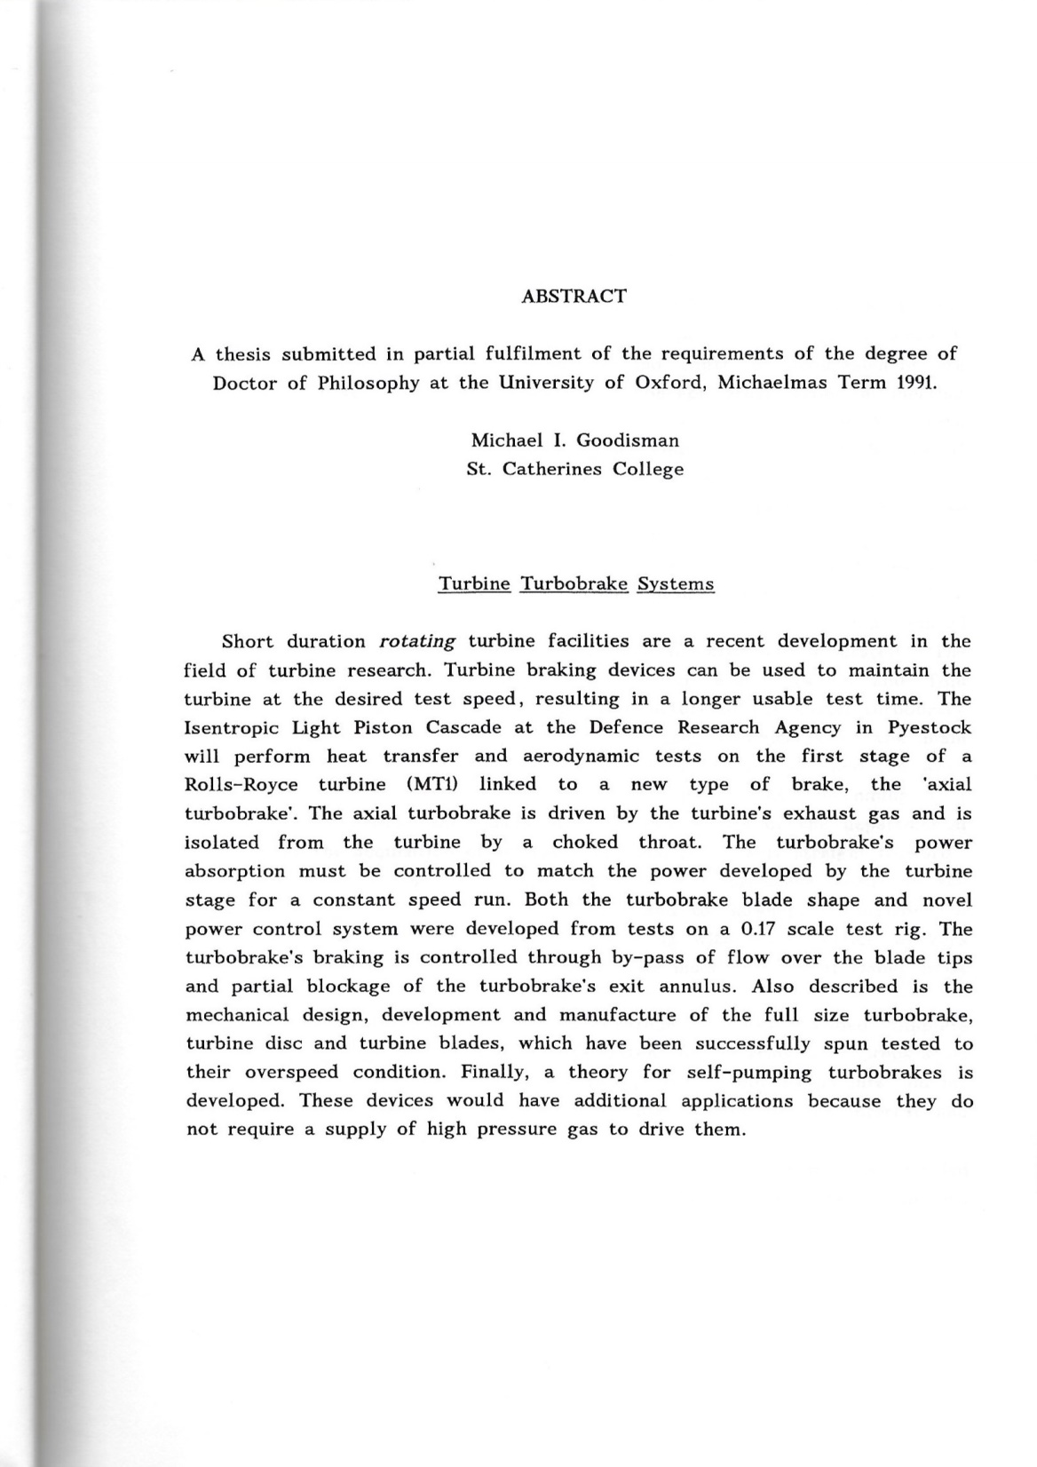
From Thesis of 1991

Slide 3
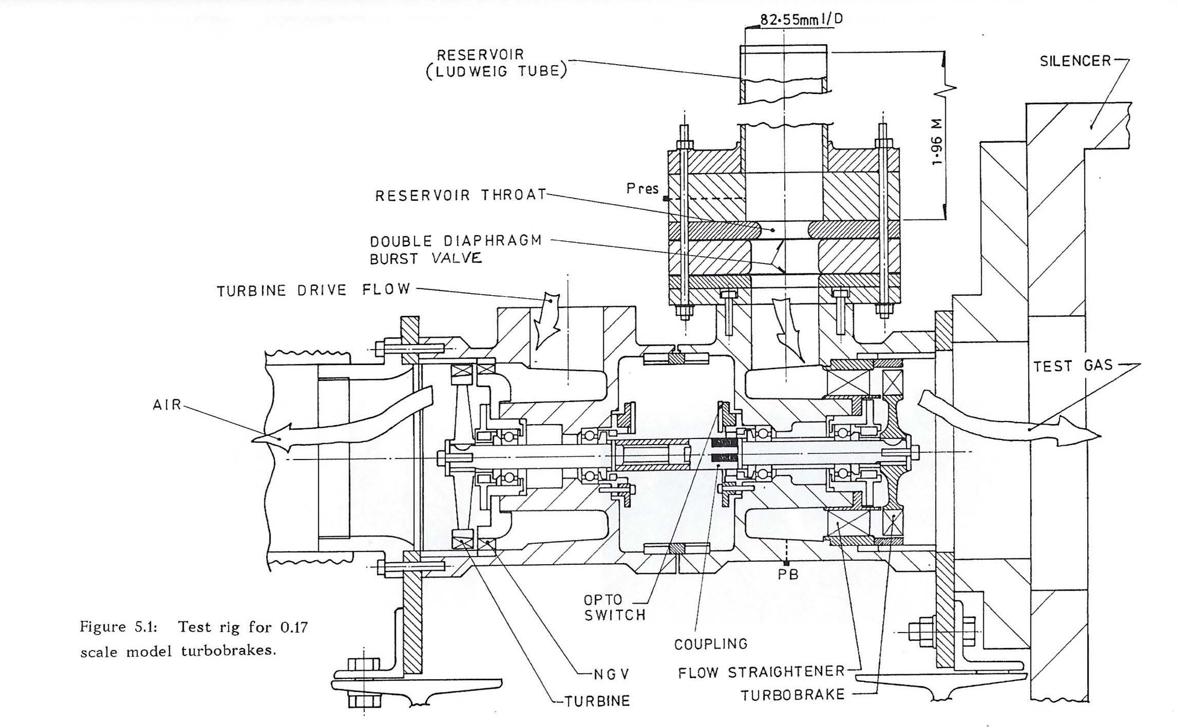
From Thesis of 1991

Slide 4
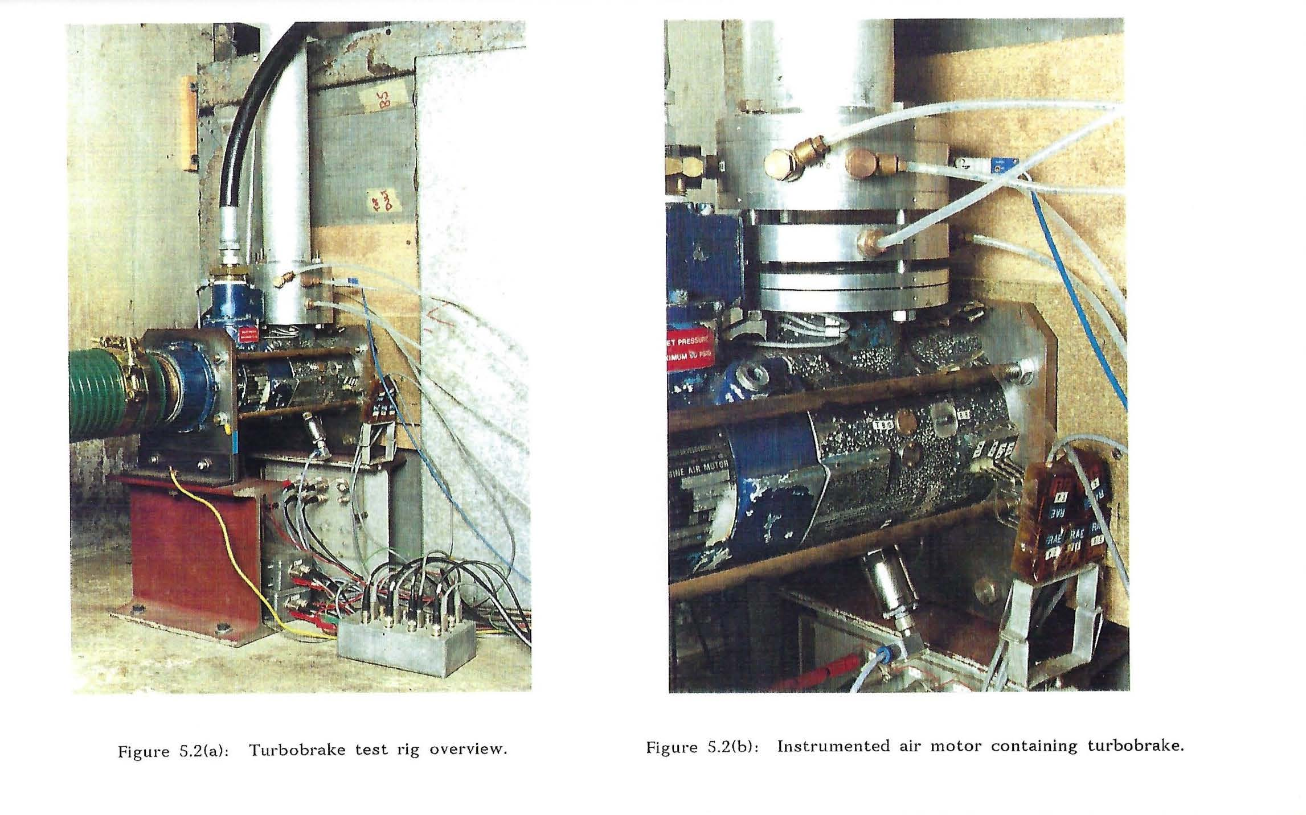
From Thesis of 1991

Slide 5
From Thesis of 1991

Slide 6
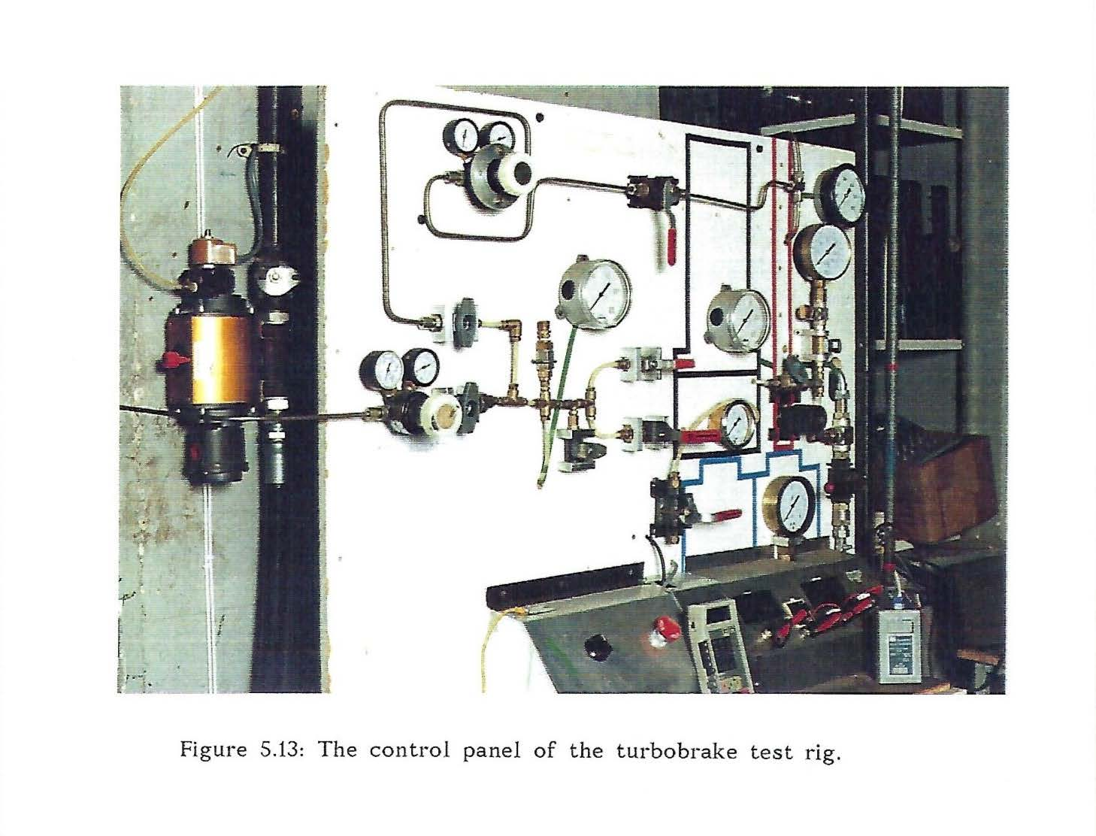
From Thesis of 1991

Slide 7
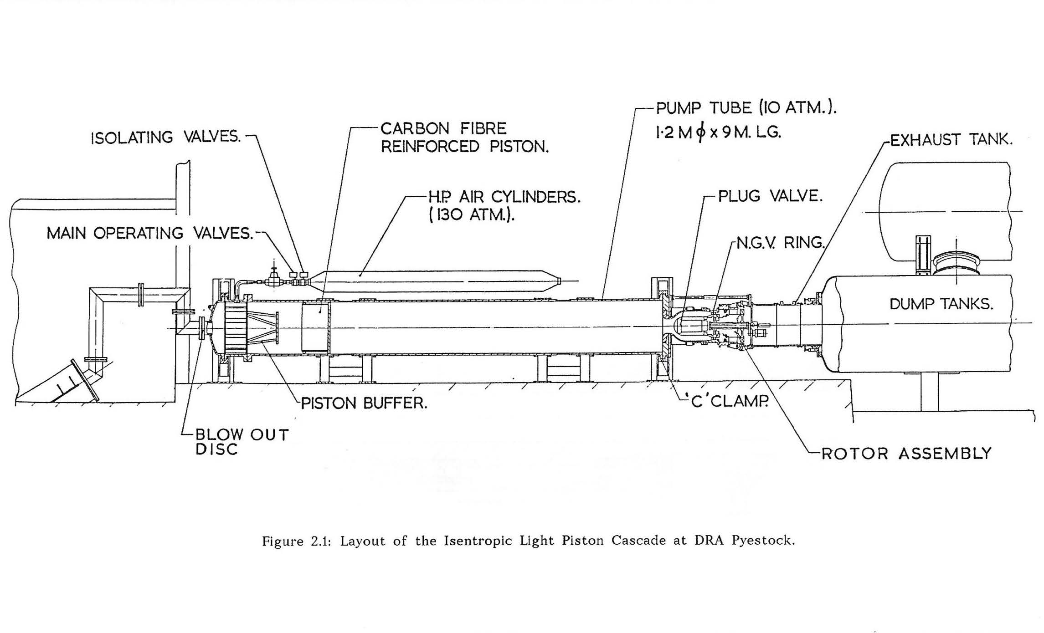
From Thesis of 1991

Slide 8
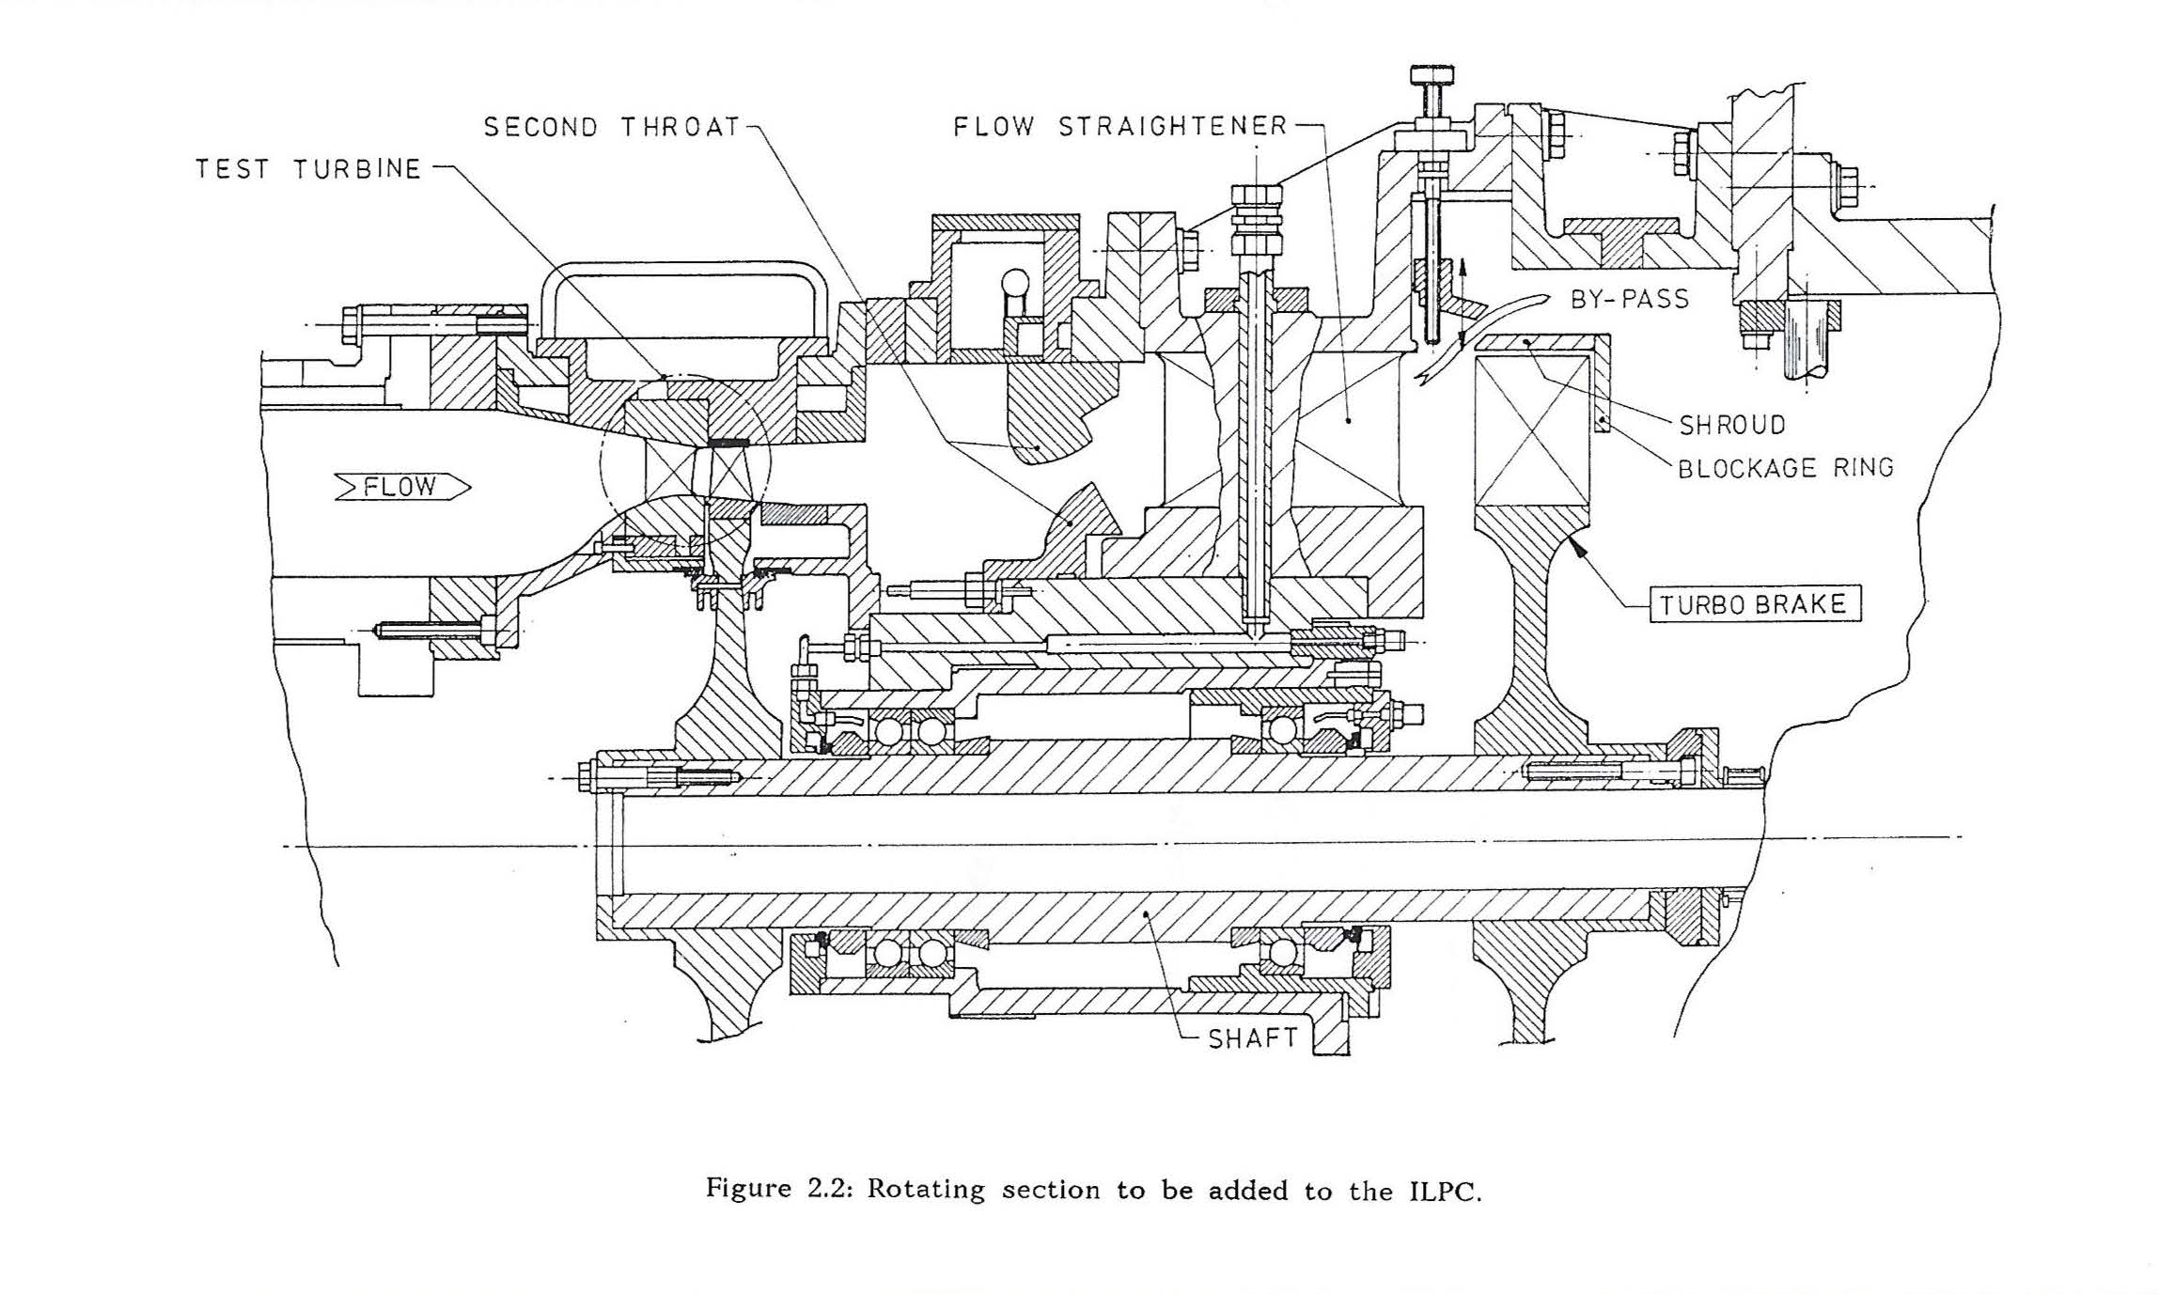
From Thesis of 1991

Slide 9
From Thesis of 1991

Slide 10
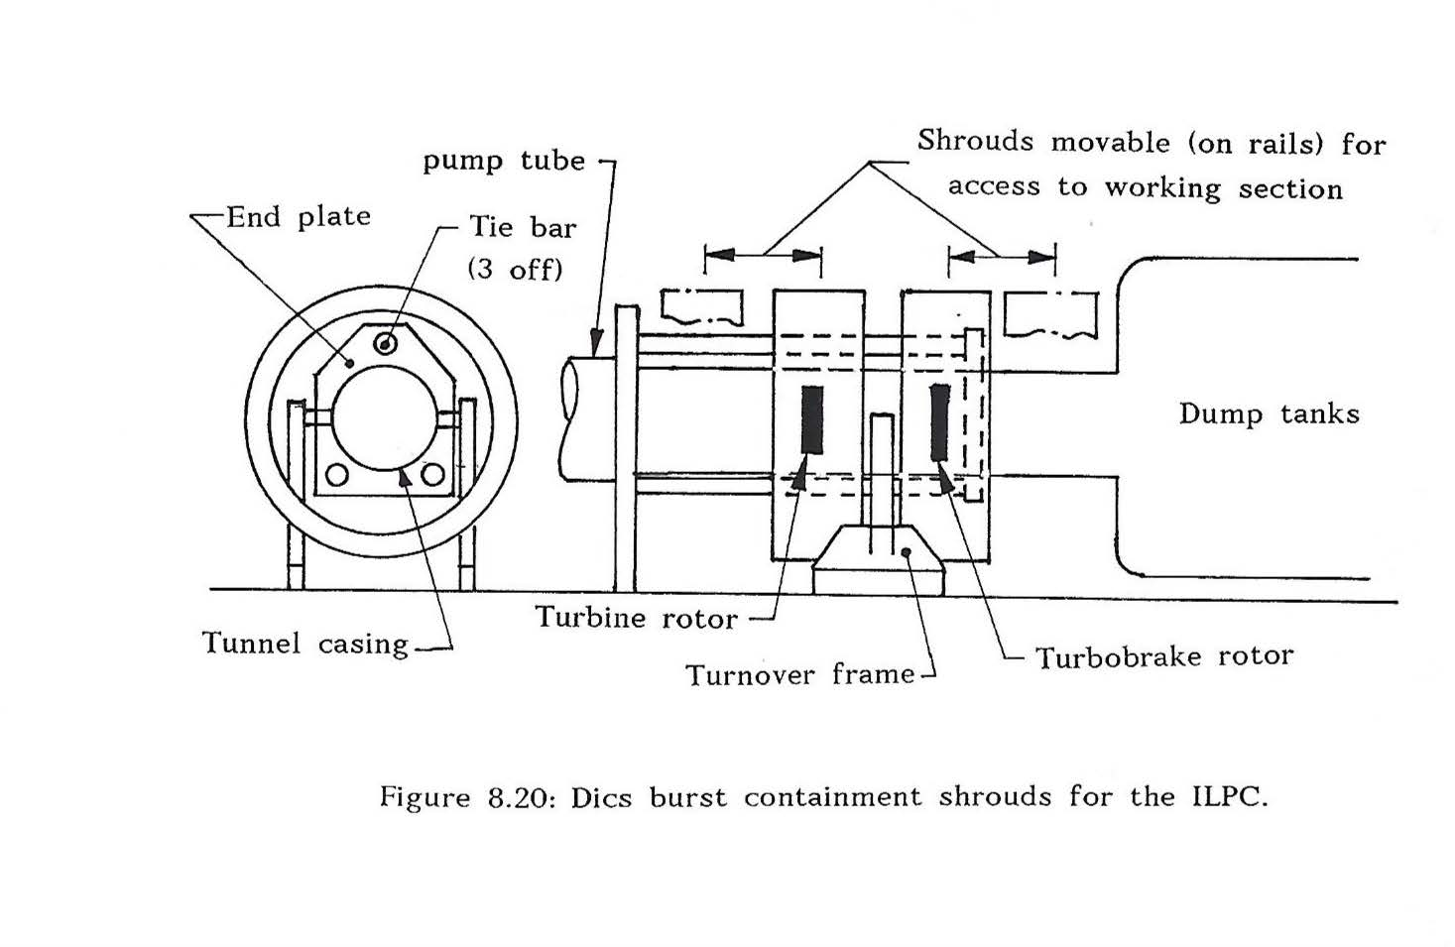
From Thesis of 1991

Slide 11
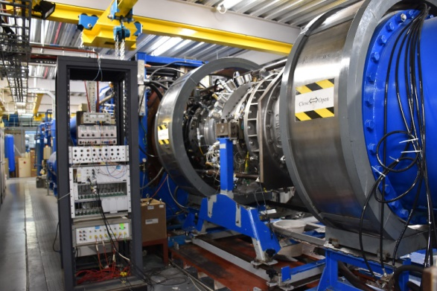
This Photo is Not From Thesis
The Oxford Turbine Research Facility (OTRF)
Also called the Isentropic Light Piston Cascade (ILPC)
Still running today!

